Slide 1

Final Project: Advanced Data Science
Customer Segmentation and Behavior Prediction

Slide 2
Introduction to data
Customer Description Data
Age
Gender
Annual income
Customer Purchasing Behavior
Total Purchases
Average Purchase Value
Product Category Most Purchased
Website Visits Last Month
Marketing Emails Opened
Hours Spent on Support Calls
Future Purchases
Notes:
data_original = original data that will not be touched
data_dummy is the original data that has dummy variables in place of the categories - use as the basis
data_dummy_integer_encoding = dummy variables and categorical rankings - hierarchal clustering
data_normalised = original data that has been normalised - k-means
data_label_categories = takes the labels - look at for customer segmentation
value_counts = look at the value of distribution for segmented values

Slide 3
Additional data to collect
Geographic location: Allows for understanding of cultural differences and local trends
Additional demographic information: Education level, occupation: Will help understand the reason for type of behavior patterns
Lifecycle stage – understanding how long someone has been a customer will help understand how behavior patterns will change over time with different customer lifecycles

Slide 4
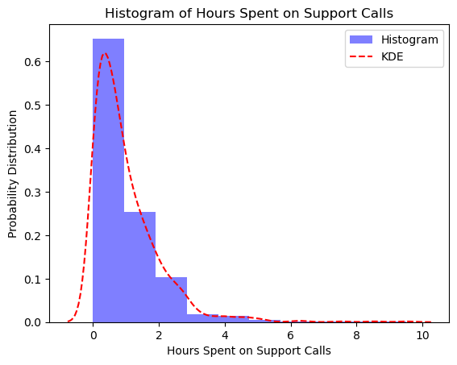
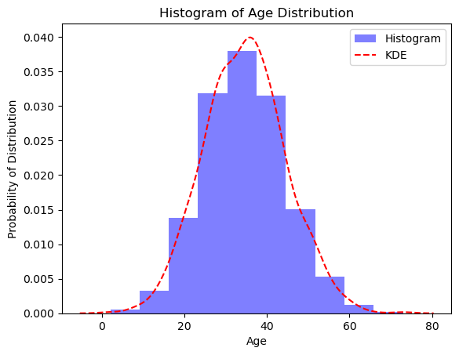
Data Distribution
Normal distribution
Age (used)
Annual income
Average purchase value
Website visits last month
Marketing emails opened
Total purchases (used)
Hours Spent on Support Calls has a majority of time close to 0. However, some people spent close to 6 hours. (used)

Slide 5
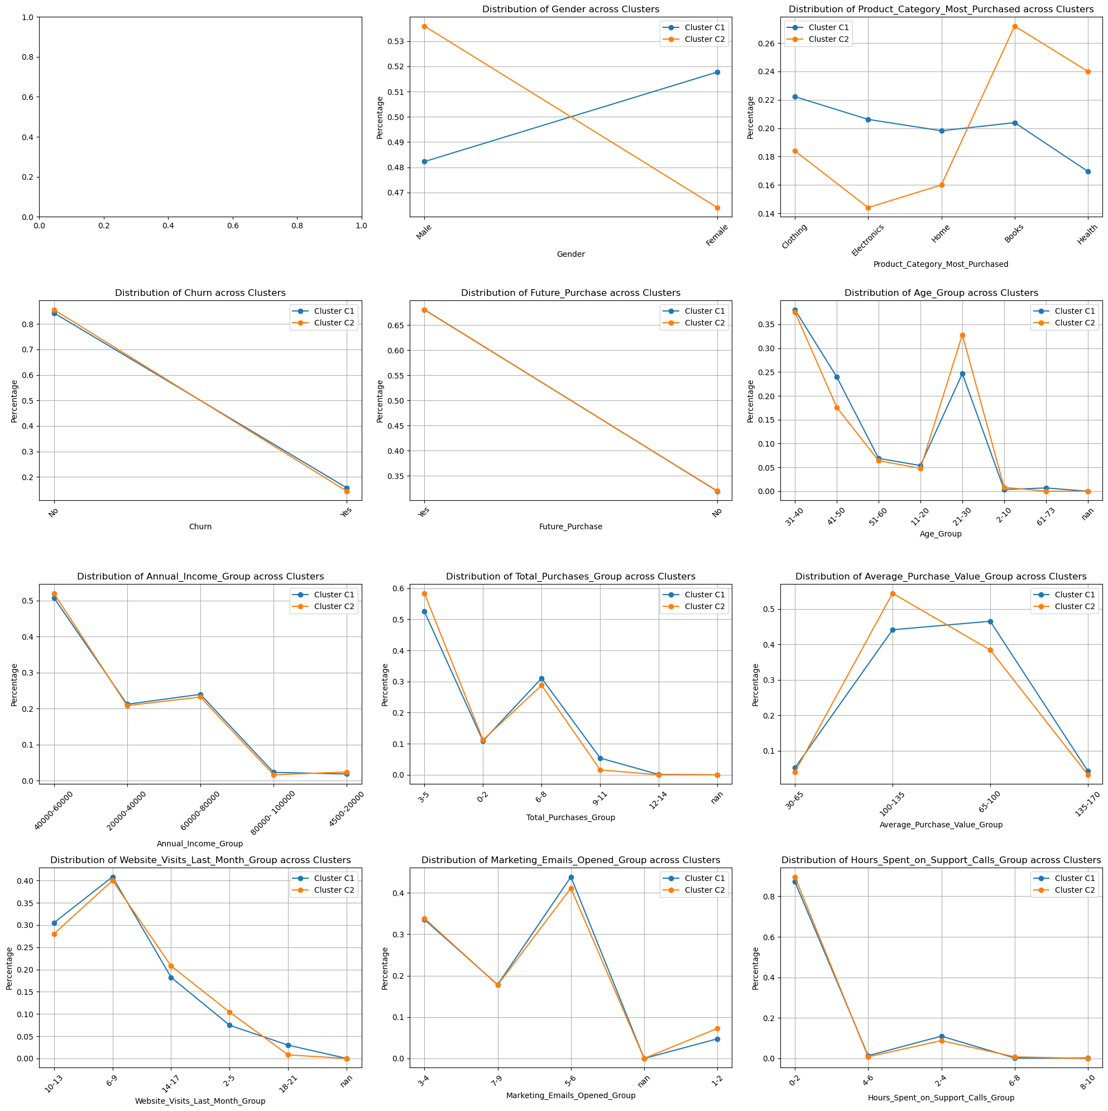
Clustering Technique 1 : K-Means
Use Integer Encoded DF

Slide 6
K-Means Cluster Characteristics
Gender: More Males in C2
Age: More 21-30 year olds in C2 but less 41-50 years old
Most Purchased: Books & Health for C2
Market to 21-30 year old males, Books and Health items

Slide 7
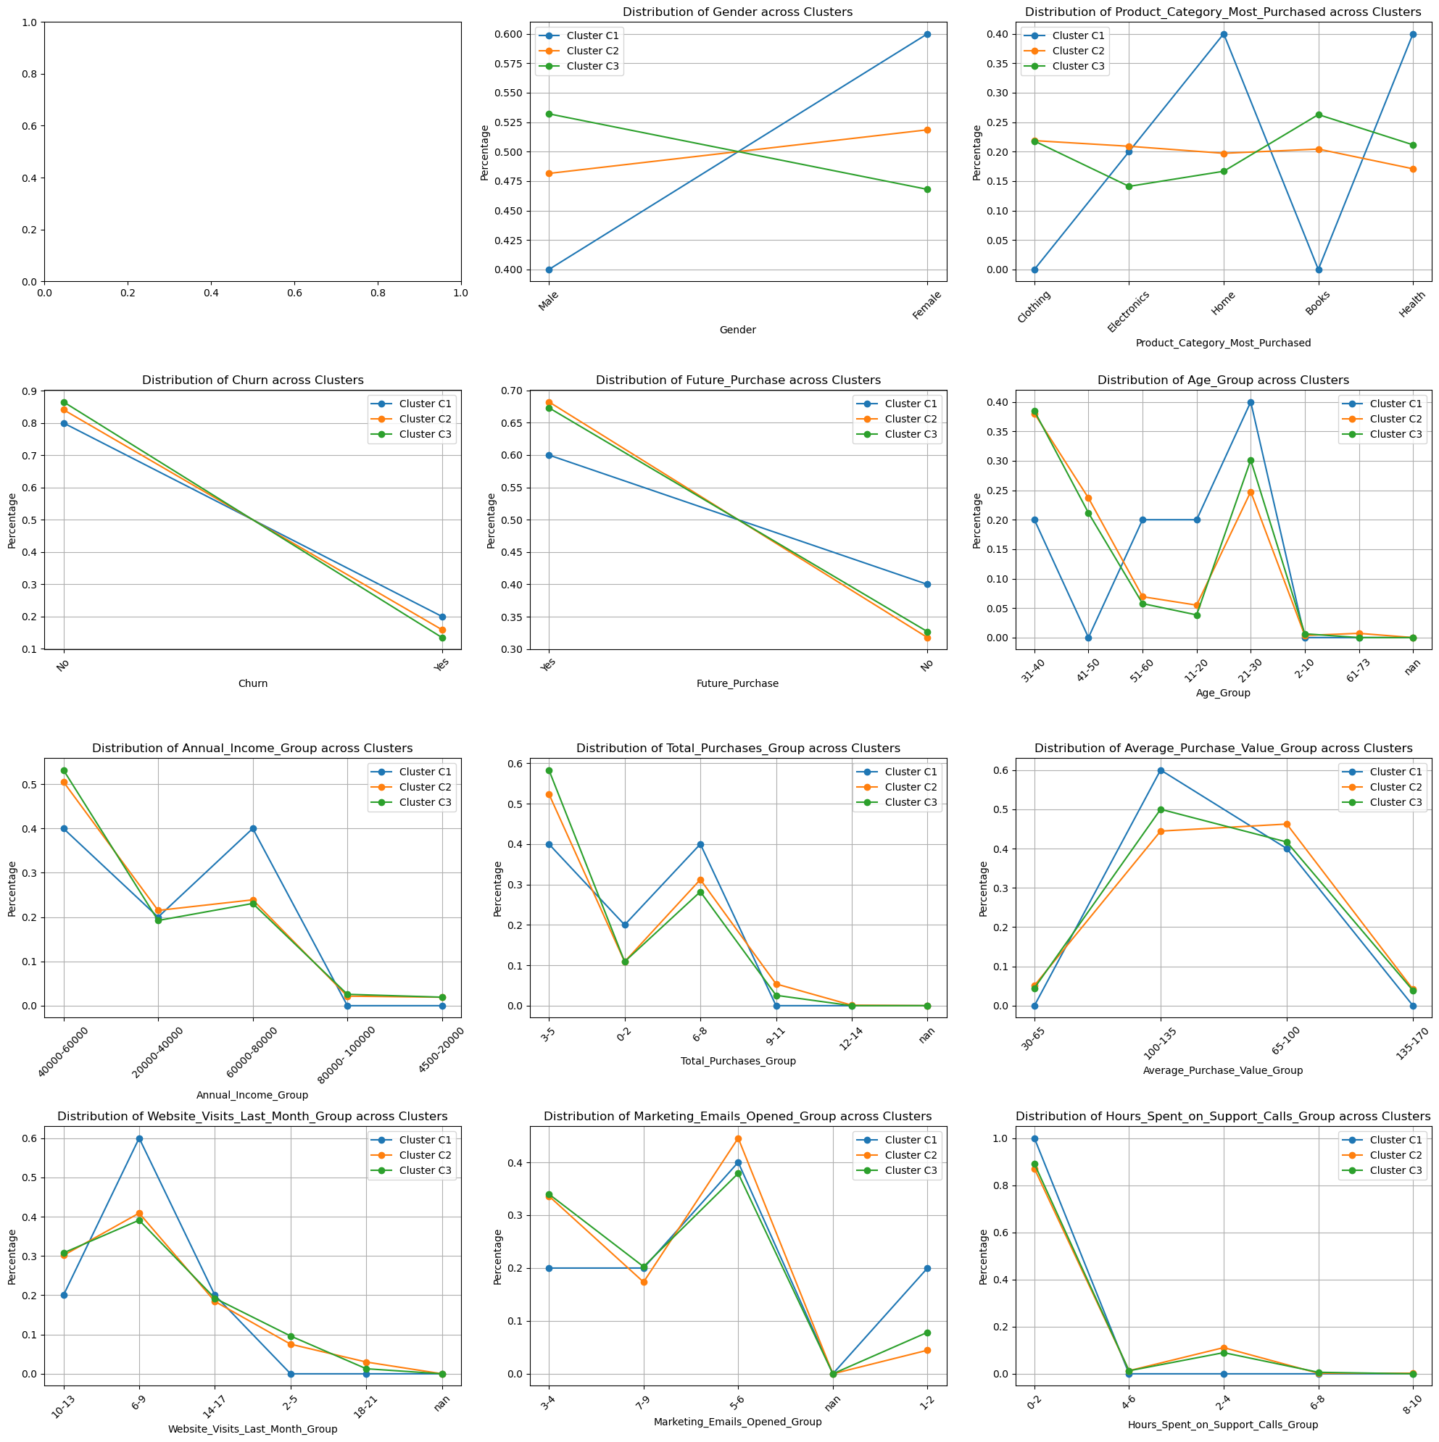
Clustering Technique 2 : Hierarchical Clustering
Use Normalised DF

Slide 8
Hierarchical Cluster Characteristics
Gender: C1 had more males than females
Age: C1 had no 41-50 year olds but far greater 31-40,51-60, 11-20 and 21-30 year olds (younger)
Annual Income: No High income earners but had more 60000-80000 (lower income earners)
C1 is lower income, younger men who opened a lot less marketing emails.
Future Purchases: Lower
Hours spent on support call: All C1 clusters was between 0-2 hours
Website Visits: Between 6-9 was the highest category
Products: Home and Health
Target home and health to young men who had lower incomes with home and health products

Slide 9
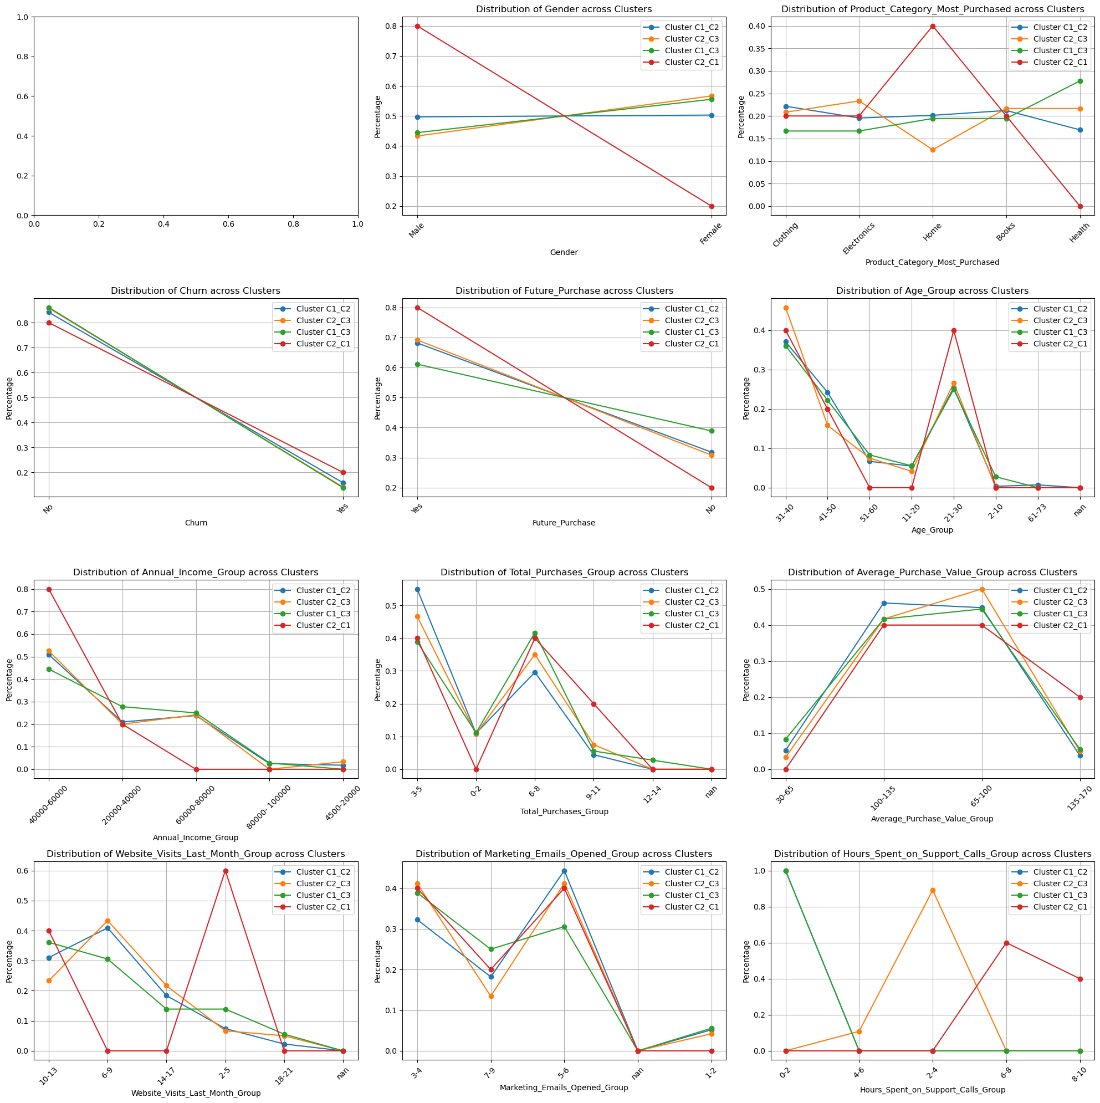
Clustering Technique 3 : Combining Clusters

Slide 10
Combined Cluster Characteristics (only 5 people)
Gender: C2_C1 mainly male
Annual Income: All was between 20,000-60000 (lower income)
Future Purchases: 0.8
Hours Spent on Support Calls: 6-10
Products: Home

Slide 11
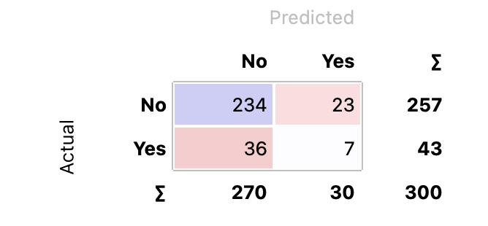
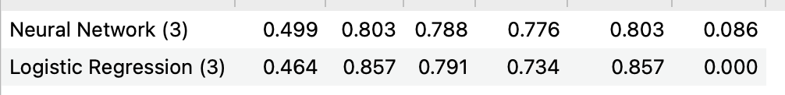
Churn Prediction
Using binning to categories values into ranges and using the following columns
Gender
Age group
Future purchases
Website visits last month
Hours spent on support calls
Products category most purchased
Using ADAM with 10,000 layers

Slide 12
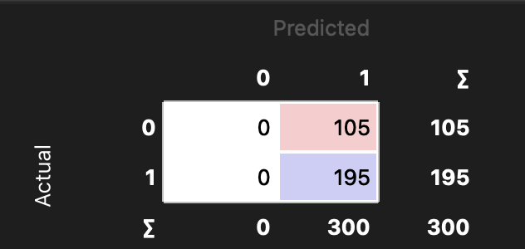
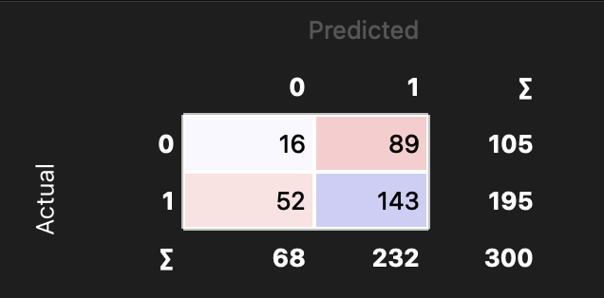
Future Purchases
Logistic Regression
Neural Network

Slide 13
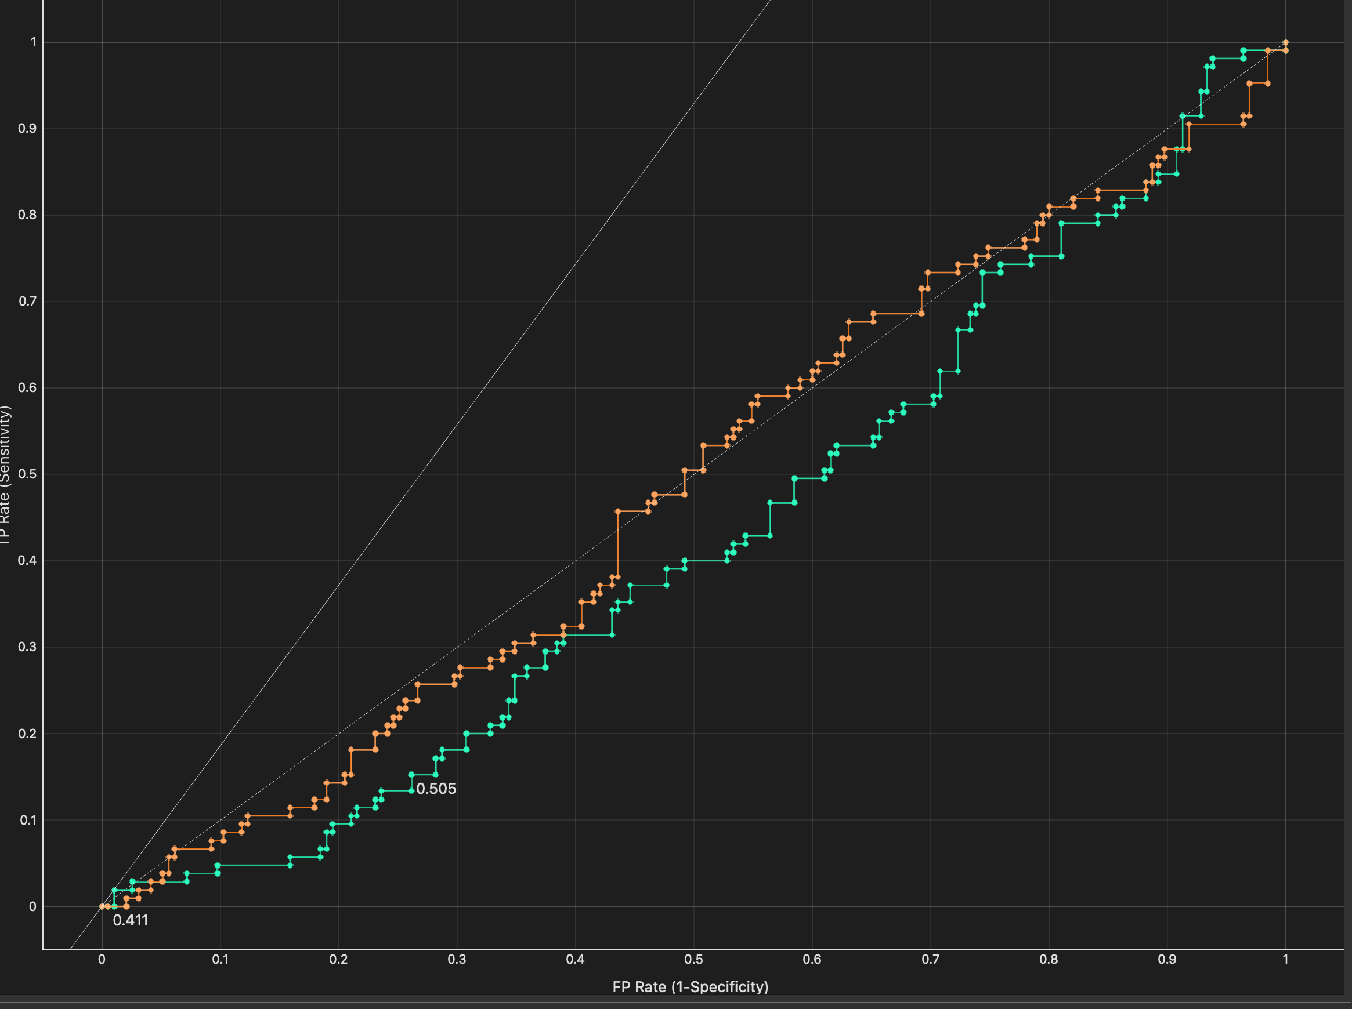
ROC Analysis

Slide 14
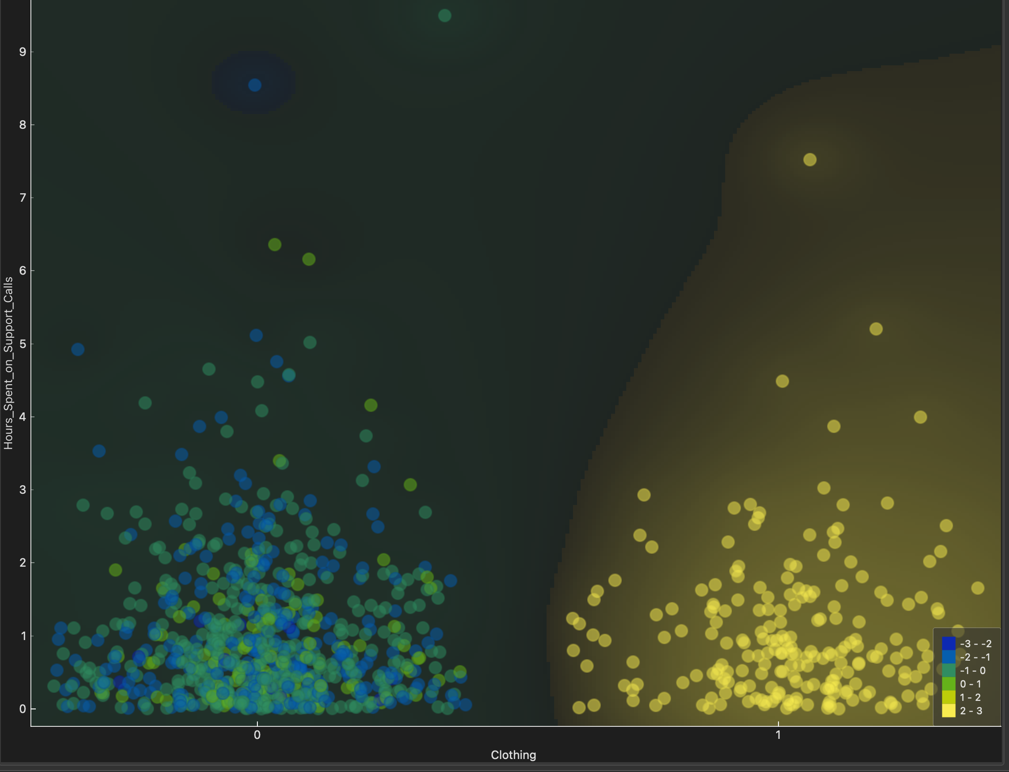
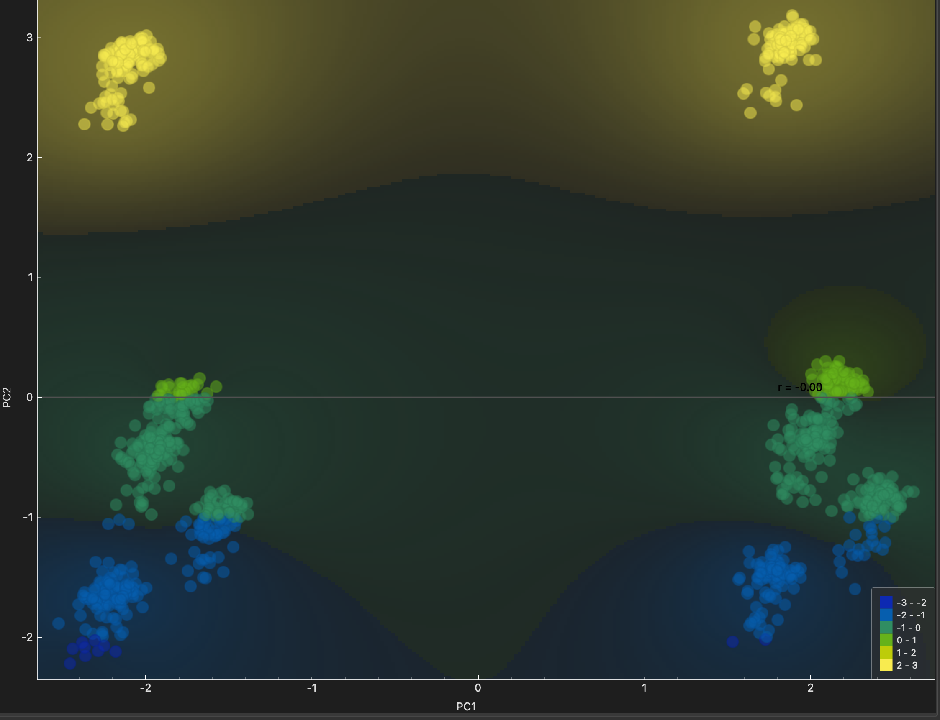
PCA Analysis
PCA Clusters
Clothing vs Hours Spent on SUpport

Slide 15
Image Analysis

